Slide 1
MATLAB Programming 2021 Spring
Final Exam One
Instructor: 黃世強 (Sai-Keung Wong)

Slide 2
Content
There are two problems. You must answer all of them.
Write a program to solve each problem. The program must be interactive. You can press keys to generate key events for your program to handle.
You can create new files for functions.
If there are templates, you can use them.

Slide 3
About demo video and demo programs.
A demo video or a demo program may have bugs. They show or illustrate roughly the results. These results may not be exactly the same as the requirements stated in the instruction. They are for your own reference and you do not need to refer to them.
You must follow the instruction to finish your programs.

Slide 4
Program file name format
Write all your programs in a folder. The folder name is mat_exam_01_student_ID. For example, if your ID is 12345678, the folder name is mat_exam_01_12345678.
Zip the folder and upload it.
Write a program for each problem in one file.
The file name is ex01_X_yourStudentID.m, where X is the problem number.
For example, if your student ID is 12345678 and the problem number is 3, then the file name must be ex01_3_12345678.m.
You must not output all the intermediate results.
Output the results that are required only.

Slide 5
File content header
At the top of the file, write down your name, ID, email address, department, and date. If you do not do so, you receive a score of zero in the corresponding problem.
%%%%%%%%%%%%%%%%%%%%%%%%%%%
% Final Exam Number: …
% Problem number: …
% Student Name: …
% Student ID: …
% Email address: …
% Department:
% Date: ….
%%%%%%%%%%%%%%%%%%%%%%%%%%%%

Slide 6
File content
For each problem, display the problem number before showing the results.
close all; clear; clc; % close all windows
% clear variables, and clear screen
disp(‘Final Exam Problem 1.1') % show Final Exam Problem 1.1

Slide 7
(40%) Problem 1.1. A simple interactive application
Plot y(x) = [z1(x) cos (z2(x)) ] / z2(x)
z1(x) = cos (x)*e^{-w sin(x)} + w sin(x)
z2(x) =(x² - 4 w x – 5w²)(|sin(2 u x)|+u)
The curve of y is divided into two or three segments due to one or two singular points.
Initially u = 0.1 and w = 1.
Display the segments in different colors. The line width of a segment is 3.
The range of x is [-10, 10]. Make sure that the segments are smooth.
Set the limits of the y axis to -1.5 and 1.5.

Slide 8
(40%) Problem 1.1. A simple interactive application
Plot the segments on the same window.
Press ‘j’ to decrease u by 0.025. Clear the figure. Plot curve y vs x.
The minimum value of u is 0.1.
Press ‘k’ to increase u by 0.025. Clear the figure. Plot curve y vs x.
Press ‘n’ to decrease w by 0.05. Clear the figure. Plot curve y vs x.
The minimum value of w is 0.
Press ‘m’ to increase w by 0.05. Clear the figure. Plot curve y vs x.
Show u and w as the title of the figure. Display each of them with at least 4 digits and decimal places.
Press ‘q’ to show the student ID on the console window, close figure window(s), and then quit the program.

Slide 9
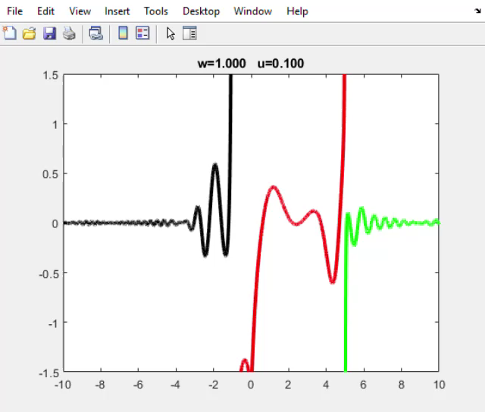
Play to see the demo.
Press ‘j’ to decrease u by 0.025.
Press ‘k’ to increase u by 0.025.
The minimum value of u is 0.1.
Press ‘n’ to decrease w by 0.05. Press ‘m’ to increase w by 0.05.
The minimum value of w is 0.

Slide 10
(40%) Problem 1.1. Marking Scheme
We use keys to change w and u.
[5%] Press ‘j’ to decrease u by 0.025.
[5%] Press ‘k’ to increase u by 0.025. The segments are correct.
[3%] The minimum value of u is 0.1.
[5%] Press ‘n’ to decrease w by 0.05. The segments are correct.
[5%] Press ‘m’ to increase w by 0.05. The segments are correct.
[2%] The minimum value of w is 0.
[10%] The segments are drawn in different colors. They are correct.
[5%] Show u and w as the title of the figure. Display each of them with at least 4 digits and decimal places..
[0%] Press ‘q’ to show the student ID on the console window, close figure window(s), and then quit the program. Deduct 20% if this item is not implemented.

Slide 11
Problem 1.2
This page is empty. Please turn to the next page.

Slide 12
(60%) Problem 1.2. An interactive system
The following shows the options of the program.
Show the main menu
‘1’: Curve drawing
‘2’: Tracing a point in a Polar plot
‘3’: Curve Morphing
‘4’: Moving Spotlight
‘m’: Return to the main menu immediately
‘q’: Quit the program when in the main menu
Press a key to perform the corresponding option.

Slide 13
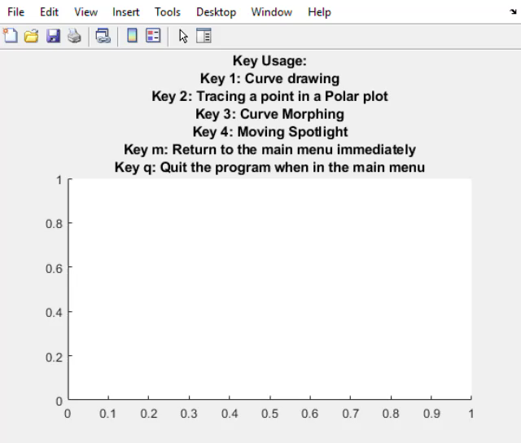
This demo shows
the first three options.
The items of the main menu are listed in the correct order.
The key usage must be clear.

Slide 14
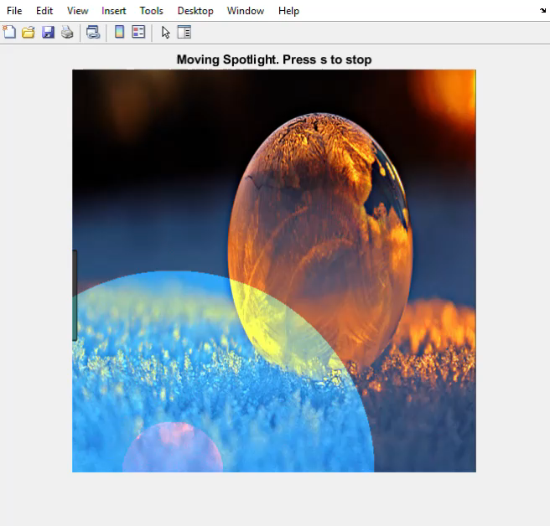
The demo shows
Moving spotlight

Slide 15
Problem 1.2. Note. You must implement the following tasks.
While an option is being handled, show the option name and the message
“Press s to stop”.
You can press ‘s’ to stop the animation.
You can press ‘r’ to return to the main menu immediately.

Slide 16
Problem 1.2. Option 1: Curve drawing
Draw the following curve interactively.
x = [-4:0.1:4];
y = 5*sin(x) * cos(e^{x}) + 3*sin(2*x) + sin(x);
Use axis([-4 4 -9 9]);
While the curve is being drawn,
its color is changing.

Slide 17
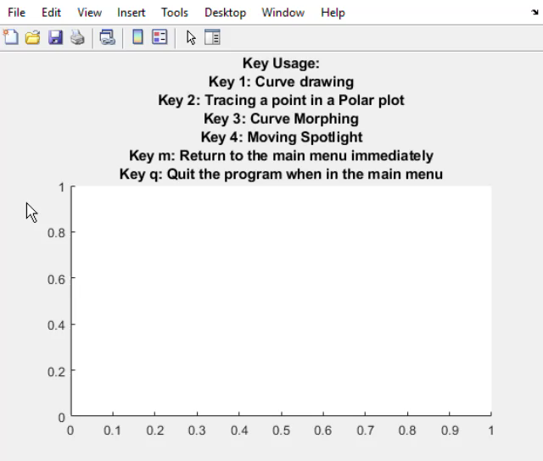
Problem 1.2. Option 2. Tracing a point in a Polar plot
Plot a curve in the polar coordinate system and fill the region. Then use a point to trace along the curve.
θ changes from 0 to 2π
r = 1 - cos(4 θ) sin(4 θ);
Set the step size of θ properly so that the curve is smooth.
Also, fill the region bounded by the curve. The region is yellow.
The curve must be visible and different from the region color.
Trace a point along the curve interactively. The point must be visible and clear.
Play to see the animation.

Slide 18
Problem 1.2. Option 3. Curve morphing
Given two parametric functions:
Set t = -10:0.025:10. The step size can be adjusted but the curves must be smooth.
We can interpolate the two functions as follows:
x(t) = (1-k) x1(t) + k x2(t)
y(t) = (1-k) y1(t) + k y2(t).
k can be computed in two ways. Thus, we produce the animation by interpolating the two functions in two plots. Let h = 0:0.01:1. The two ways are: k = h and k = sin²(h*π).
There must be two plots (use subplots). Each plot shows one interpolation result. The animation must be smooth and interactive. Make sure that the figure window is on top.
Function 1 x1(t) = a1 * cos( n1*t + c1 ); y1(t) = b1 * sin(t) * cos( t ); a1 = 10; b1 = 5; c1 = 0; n1 = 3; t is the independent variable. | Function 2 x2(t) = a2 * ( 2 cos(t) – cos(5t) ); y2(t) = a2 * ( 2 sin(t) – cos(5t) ); a2 = 5;

Slide 19
Problem 1.2. Option 4. Spotlight Animation
Play to see the animation.
Load an image. Resize the image to 480x480. Produce an animation similar to the example on the right side.
Move a spotlight with two regions (with different intensities) along the boundary of the image in counter-clockwise direction.
There are two regions affected by the spotlight: center and outer. The center region becomes brighter. In the outer region, the green and blue components become stronger.

Slide 20
(60%) Problem 1.2. Marking Scheme
(5%) Show the main menu.
(5%) Option 1: the animation is correct (curve color is changing, …).
(5%) Option 2: the animation is correct (moving point, filled region, …).
(5%) Option 3: the animation is correct (two subplots, interpolation, …).
(5%) Option 4: the animation is correct (color, counterclockwise, …).
(5%) Handle all the key events (‘s’ and ‘m’) correctly in options 1 and 2.
(5%) Handle all the key events (‘s’ and ‘m’) correctly in options 3 and 4.
(4%) Handle at the least 2 options correctly (animation and key events).
(10%) Handle at least 3 options correctly (animation and key events).
(10%) Handle all the four options correctly (animation and key events).
(1%) Press ‘q’ to show student ID, close all figure windows, and then quit the program. If you do not implement this item, deduct 20%.

Slide 21
End
Enjoy MATLAB Programming.

